Slide 1

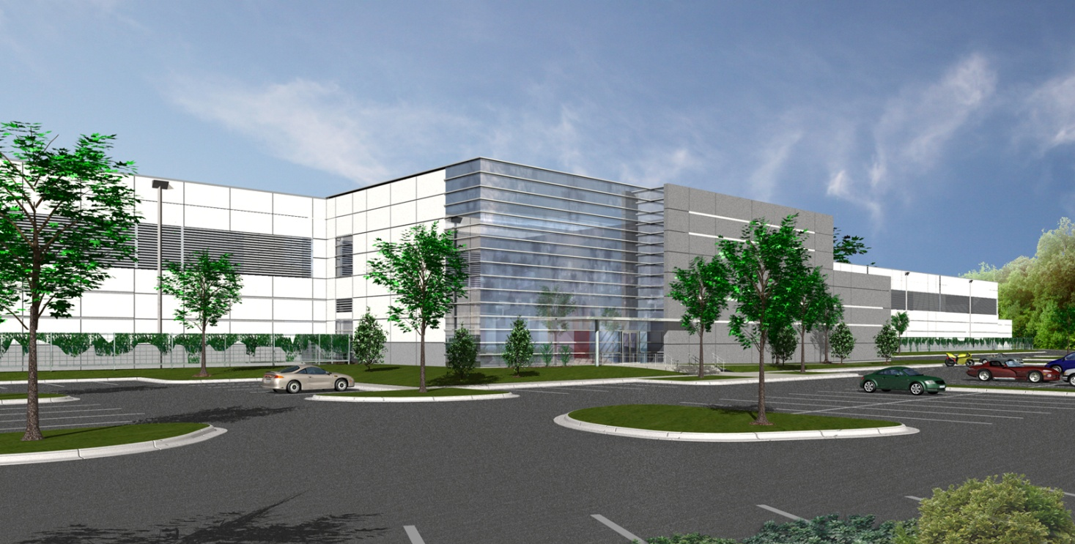
Mid-Atlantic Data Center 5
Ashburn, Virginia
Lindsay A. Hagemann
Senior Thesis Presentation 2009
The Pennsylvania State University
B.A.E./M.A.E. Program
Construction Management

Slide 2

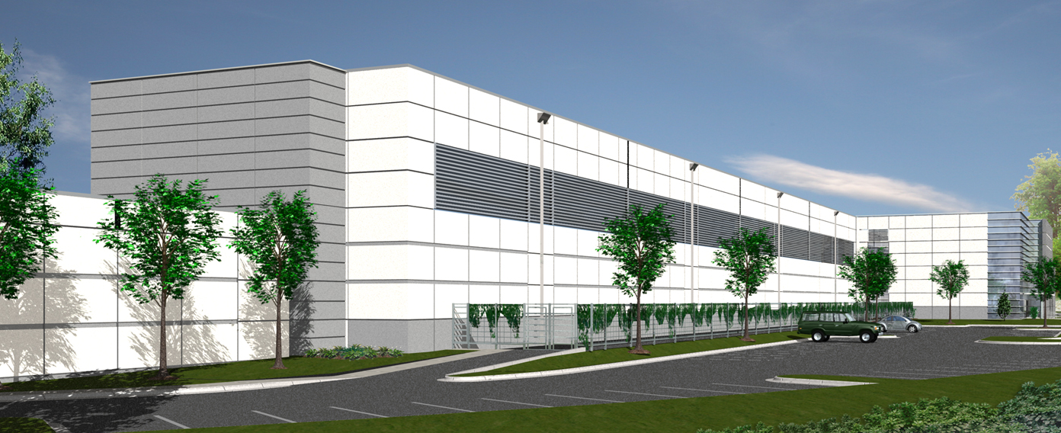
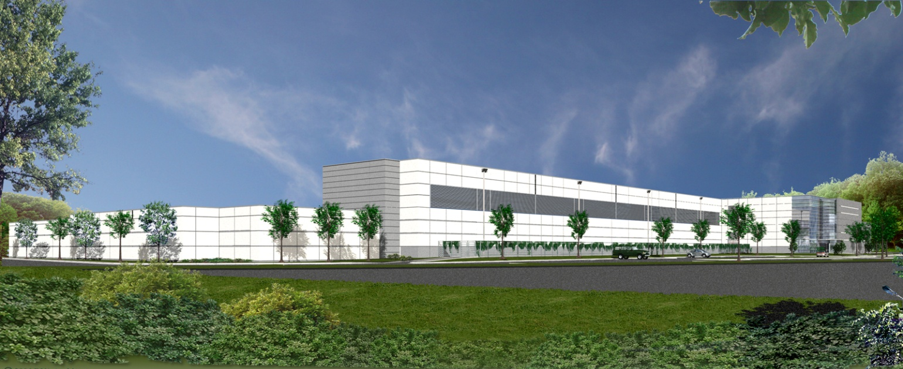
Presentation Outline
Project Overview
Industry & the Economy
  Existing Schedule & Cash Flow
  Project Execution Plan
  Conclusions & Recommendations
Alternative Concrete Construction Process
  Constructability Analysis
  Schedule Analysis
  Cost Analysis
  Conclusions & Recommendations
Energy Efficient Technologies
  Thin Film PV’s
  Water-side Economizers
Conclusions & Recommendations
Q & A
Lindsay Hagemann | Construction Management
Mid-Atlantic Data Center 5 Ashburn, Virginia
April 13, 2009

Slide 3
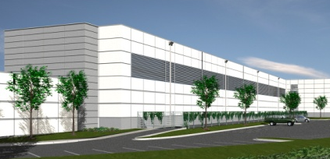

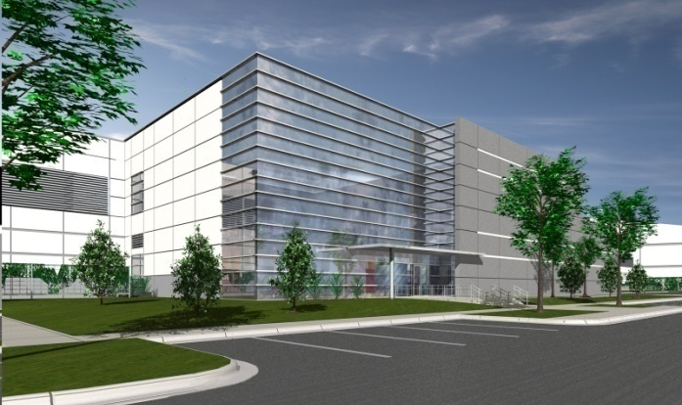
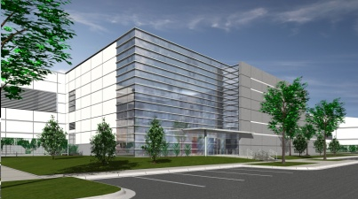



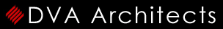

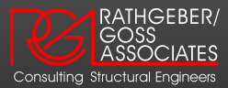
Project Overview
Project Overview
Project Overview
Industry & the Economy
  Existing Schedule & Cash Flow
  Project Execution Plan
  Conclusions & Recommendations
Alternative Concrete Construction Process
  Constructability Analysis
  Schedule Analysis
  Cost Analysis
  Conclusions & Recommendations
Energy Efficient Technologies
  Thin Film PV’s
  Water-side Economizers
Conclusions & Recommendations
Q & A
Project Team
Function: Data Center
Size: 360,000 SF Total
180,000 SF Raised Floor
23,000 SF Office Space
Height: 2 Stories
Redundancy: N+2
Construction: 2 Phases
Schedule: February 2008 – March 2009
Delivery Method: CM @ Risk w/ Cost + Fee
Owner
Construction Manager
Architect
MEP Engineer
Structural Engineer
Lindsay Hagemann | Construction Management
Mid-Atlantic Data Center 5 Ashburn, Virginia
April 13, 2009

Slide 4
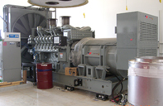
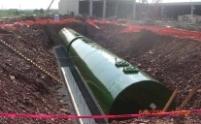
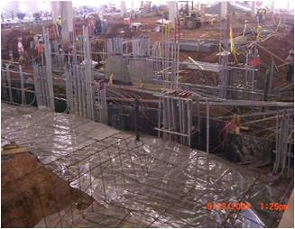
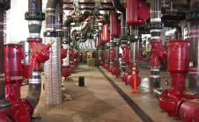
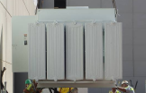
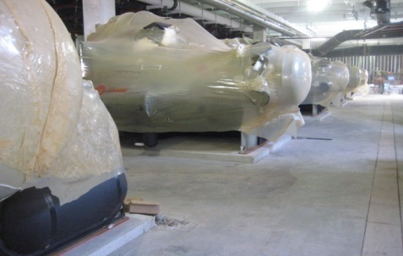
Project Overview
Project Overview
Project Overview
Industry & the Economy
  Existing Schedule & Cash Flow
  Project Execution Plan
  Conclusions & Recommendations
Alternative Concrete Construction Process
  Constructability Analysis
  Schedule Analysis
  Cost Analysis
  Conclusions & Recommendations
Energy Efficient Technologies
  Thin Film PV’s
  Water-side Economizers
Conclusions & Recommendations
Q & A
Electrical System
Mechanical System
*Total System
  34.5 kV Total Utility Power
  59.6 MW Total Electrical Load
*Equipment per phase
  (8) 600 V Pad-Mounted Transformers w/ Integral VFI
  (16) 2500 kW Engine-Generators
  (16) UPS Systems
*Equipment per phase
  (3) 14,400-23,000 cfm AHU’s in Chiller Plant
  (8) 1080 ton Chillers
  (8) 3240 gpm Cooling Towers
  (240) 18,000 cfm CRAH’s Units
  (2) 50,000 gal Underground Diesel Storage Tanks
Lindsay Hagemann | Construction Management
Mid-Atlantic Data Center 5 Ashburn, Virginia
April 13, 2009

Slide 5
Industry & the Economy
Industry & the Economy
Project Overview
Industry & the Economy
  Existing Schedule & Cash Flow
  Project Execution Plan
  Conclusions & Recommendations
Alternative Concrete Construction Process
  Constructability Analysis
  Schedule Analysis
  Cost Analysis
  Conclusions & Recommendations
Energy Efficient Technologies
  Thin Film PV’s
  Water-side Economizers
Conclusions & Recommendations
Q & A
Background
  Owner views as one project, Project Seven, including 3 data centers
    Northwest Data Center (NWDC) in Santa Clara, CA
    Northeast Data Center (NEDC) in Piscataway, NJ
    Mid-Atlantic Data Center 5 (MADC5) in Ashburn, VA
Goals
  Evaluate:
      Current economy and Project Seven status
      Project schedule & cost projections
  Develop a project execution plan to successfully complete Project Seven in a down economy.
Problem
  Project Seven has been completely suspended.
    NWDC August 2008
    NEDC October 2008
    MADC5 November 2008
  DuPont Fabros maintains several completely leased data centers producing steady revenue.
Lindsay Hagemann | Construction Management
Mid-Atlantic Data Center 5 Ashburn, Virginia
April 13, 2009

Slide 6
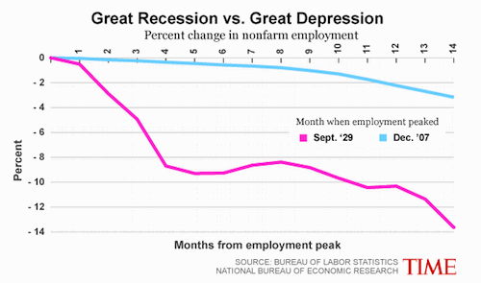
Industry & the Economy
Industry & the Economy
Project Overview
Industry & the Economy
  Existing Schedule & Cash Flow
  Project Execution Plan
  Conclusions & Recommendations
Alternative Concrete Construction Process
  Constructability Analysis
  Schedule Analysis
  Cost Analysis
  Conclusions & Recommendations
Energy Efficient Technologies
  Thin Film PV’s
  Water-side Economizers
Conclusions & Recommendations
Q & A
Economy
  September 2007: Economy slowly declines to a temporary halt.
  January 2008: Begins another continual decrease.
  November 2008: Government finally declares a recession.
Construction Industry
  Trouble securing loans and allocating funds
    Operate on rolling-over short-term loans
  Projects are suspended, shut down, postponed
  Causes:
    “Credit Crunch”
    Federal Reserve response to a tightening of available capital
Lindsay Hagemann | Construction Management
Mid-Atlantic Data Center 5 Ashburn, Virginia
April 13, 2009

Slide 7
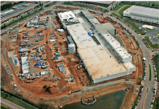
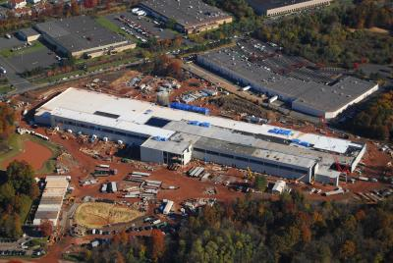
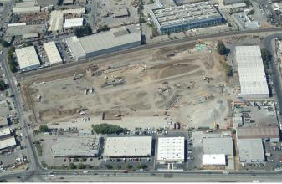
Industry & the Economy
Industry & the Economy
Project Overview
Industry & the Economy
  Existing Schedule & Cash Flow
  Project Execution Plan
  Conclusions & Recommendations
Alternative Concrete Construction Process
  Constructability Analysis
  Schedule Analysis
  Cost Analysis
  Conclusions & Recommendations
Energy Efficient Technologies
  Thin Film PV’s
  Water-side Economizers
Conclusions & Recommendations
Q & A
Entering New Markets
Simultaneous Projects
Ideal:
  Growing company in a growing economy
  Suitable locations
  Economic stability
Plan: Approximately $520 million within 20 months
  Mid-Atlantic Data Center 5 (top) 360,000 SF
  Northeast Data Center (middle) 366,000 SF
  Northwest Data Center (bottom) 362,000 SF
Region | Information
Northern Virginia | “If software center Seattle is the new economy's brain and chipmaking Silicon Valley is its heart, then Washington is its central nervous system. Spread along, around and mostly under the Dulles Toll Road, are the vital electronic pathways that carry more than half of all traffic on the Internet. The region is home to more telecom and satellite companies than any other place on earth. It's not a coincidence that Virginia license plates recently got a new slogan: THE INTERNET CAPITAL OF THE WORLD.”
Piscataway, NJ | “Metro New York was prominent in the tech-service category, with many of its workers in telecommunications, Internet services, R&D and testing labs, and computer training services.”
Santa Clara, CA (Silicon Valley) | “Silicon Valley continues to maintain its status as one of the top research and development centers in the world. Thousands of high technology companies are headquartered in Silicon Valley.”
Lindsay Hagemann | Construction Management
Mid-Atlantic Data Center 5 Ashburn, Virginia
April 13, 2009

Slide 8
Existing Schedule/Cash Flow
Existing Schedule/Cash Flow
Project Overview
Industry & the Economy
  Existing Schedule & Cash Flow
  Project Execution Plan
  Conclusions & Recommendations
Alternative Concrete Construction Process
  Constructability Analysis
  Schedule Analysis
  Cost Analysis
  Conclusions & Recommendations
Energy Efficient Technologies
  Thin Film PV’s
  Water-side Economizers
Conclusions & Recommendations
Q & A
Original Plan
Actual Plan
Project Seven Duration: 20 months
  Start: February 2008
  Finish: September 2009
Project | Start | Suspended | Finish | Orig. Duration (months) | Suspension (months) | Total Duration (months)
MADC5 | Feb 2008 | Aug 2008 | July 09 | 15 | 3 | 18
NEDC | May 2008 | Oct 2008 | Mar 10 | 13 | 10 | 23
NWDC | July 2008 | Nov 2008 | Apr 10 | 15 | 20 | 35
TOTAL | Feb 2008 | - | Apr 10 | - | - | 40
Project | Start | Finish | Orig. Duration (months) | Overlap (months)
MADC5 | Feb 2008 | Apr 2009 | 15 | -
NEDC | May 2008 | May 2009 | 13 | 11
NWDC | July 2008 | Sept 2009 | 15 | 10
Total | Feb 2008 | Sept 2009 | 20 | -
After temporary suspensions and restarts, the project duration is 40 months.
  Start: February 2008
  Finish: April 2010
Lindsay Hagemann | Construction Management
Mid-Atlantic Data Center 5 Ashburn, Virginia
April 13, 2009

Slide 9
Existing Schedule/Cash Flow
Existing Schedule/Cash Flow
Project Overview
Industry & the Economy
  Existing Schedule & Cash Flow
  Project Execution Plan
  Conclusions & Recommendations
Alternative Concrete Construction Process
  Constructability Analysis
  Schedule Analysis
  Cost Analysis
  Conclusions & Recommendations
Energy Efficient Technologies
  Thin Film PV’s
  Water-side Economizers
Conclusions & Recommendations
Q & A
Original Plan
Actual Plan
First Suspension (NWDC): -$50.4 million
Second Suspension (NWDC): -$87.9 million
Third Suspension (MADC5): -$92.5 million
-$92.5 million deemed the “suspension value” – stay above to complete Project Seven
Total Construction Cost = $520 million.
May 2009 = ultimate low net income of -$298.9 million.
Lindsay Hagemann | Construction Management
Mid-Atlantic Data Center 5 Ashburn, Virginia
April 13, 2009

Slide 10
Project Execution Plan
Project Execution Plan
Project Overview
Industry & the Economy
  Existing Schedule & Cash Flow
  Project Execution Plan
  Conclusions & Recommendations
Alternative Concrete Construction Process
  Constructability Analysis
  Schedule Analysis
  Cost Analysis
  Conclusions & Recommendations
Energy Efficient Technologies
  Thin Film PV’s
  Water-side Economizers
Conclusions & Recommendations
Q & A
Option 1 | Prolong Projects
P7 Plan
Schedule:
  Decrease in the amount of work performed each month
  Lengthen the OPS significantly
Evaluate
  Owner’s construction expenditures
  Construction schedule
  Existing revenue
Successful completion of Project Seven could occur :
  Prolong each project schedule.
  Maintain durations and sequence projects with a finish-to-start relationship.
  Maintain durations with less of an overlap than the original plan.
Cash Flow:
  Cost increase in equipment rental, labor, GC’s, and O&P
  Delay in receiving revenue from each project due to leased spaces.
    Limits the amount of overlap between each project
    OPS further delayed to remain above the suspension point
Lindsay Hagemann | Construction Management
Mid-Atlantic Data Center 5 Ashburn, Virginia
April 13, 2009

Slide 11
Project Execution Plan
Project Execution Plan
Project Overview
Industry & the Economy
  Existing Schedule & Cash Flow
  Project Execution Plan
  Conclusions & Recommendations
Alternative Concrete Construction Process
  Constructability Analysis
  Schedule Analysis
  Cost Analysis
  Conclusions & Recommendations
Energy Efficient Technologies
  Thin Film PV’s
  Water-side Economizers
Conclusions & Recommendations
Q & A
Option 2 | Maintain Durations w/ Sequential Projects
Schedule:
  Projects constructed with finish-start relationship
  Lengthen the OPS significantly
Project | Start | Finish | Orig. Duration (months)
MADC5 | Feb 2008 | Apr 2009 | 15
NEDC | May 2009 | May 2010 | 13
NWDC | June 2009 | Aug 2011 | 15
Total | Feb 2008 | Aug 2011 | 43
Cash Flow:
  Same cash flow as actual plan
  Remains above suspension point
  Delays potential revenue
Lindsay Hagemann | Construction Management
Mid-Atlantic Data Center 5 Ashburn, Virginia
April 13, 2009

Slide 12
Project Execution Plan
Project Execution Plan
Project Overview
Industry & the Economy
  Existing Schedule & Cash Flow
  Project Execution Plan
  Conclusions & Recommendations
Alternative Concrete Construction Process
  Constructability Analysis
  Schedule Analysis
  Cost Analysis
  Conclusions & Recommendations
Energy Efficient Technologies
  Thin Film PV’s
  Water-side Economizers
Conclusions & Recommendations
Q & A
Option 3 | Maintain Durations w/ Less Overlap
Schedule:
  Less extreme project overlaps – finish-start
    Original = NEDC 11 month NWDC 10 month
    New = NEDC 5 month NWDC 2 month
  Shorter OPS by 6 months
Project | Start | Finish | Orig. Duration (months) | Overlap (months)
MADC5 | Feb 2008 | Apr 2009 | 15 | -
NEDC | Nov 2008 | Nov 2009 | 13 | 5
NWDC | Sept 2009 | Nov 2010 | 15 | 2
Total | Feb 2008 | Nov 2010 | 34 | -
Cash Flow:
  No added costs or suspension
  Nears suspension at completion of NEDC and start-up NWDC
  Receive revenue earlier causing drastic increase in cash flow at the end
    Able to start another project
Lindsay Hagemann | Construction Management
Mid-Atlantic Data Center 5 Ashburn, Virginia
April 13, 2009

Slide 13
Conclusions
Recommendations
Project Overview
Industry & the Economy
  Existing Schedule & Cash Flow
  Project Execution Plan
  Conclusions & Recommendations
Alternative Concrete Construction Process
  Constructability Analysis
  Schedule Analysis
  Cost Analysis
  Conclusions & Recommendations
Energy Efficient Technologies
  Thin Film PV’s
  Water-side Economizers
Conclusions & Recommendations
Q & A
Given the economic times, the possibility of successfully constructing all three projects is nonexistent.
Option | Start | Finish | Orig. Duration (months) | Income at Nov 2010 | Add’l Revenue
Actual Project Duration | Feb 2008 | May 2011 | 40 | $452,599,560 | $0
1. Prolong Projects | Feb 2008 | ? | ? | - | -
2. Maintain Duration with Sequential Projects | Feb 2008 | Aug 2011 | 43 | $457,185,960 | $4,586,400
3. Maintain Durations with Less Overlap | Feb 2008 | Nov 2010 | 34 | $485,850,960 | $33,251,400
*Maintain the schedule durations with less of an overlap*
  6 months shorter than actual schedule
  Produces $33,251,400 of additional revenue
  Future development
Lindsay Hagemann | Construction Management
Mid-Atlantic Data Center 5 Ashburn, Virginia
April 13, 2009

Slide 14
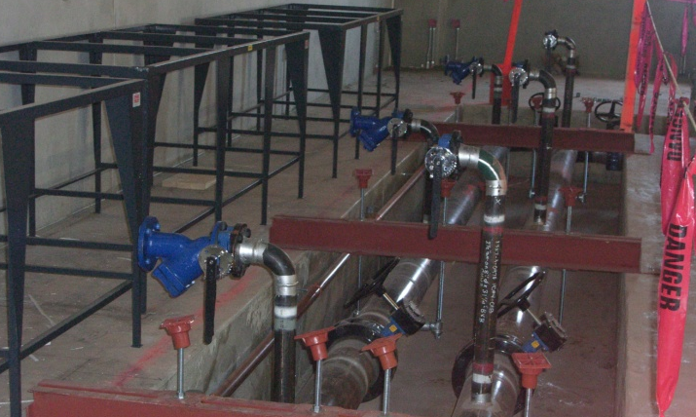
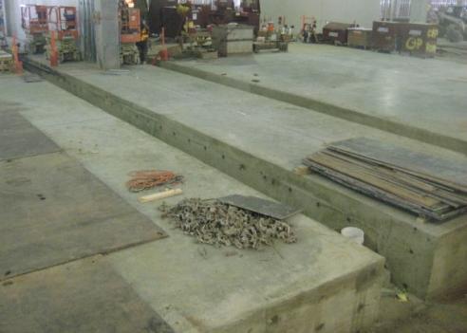
Alt. Concrete Constr. Process
Alt. Concrete Constr. Process
Project Overview
Industry & the Economy
  Existing Schedule & Cash Flow
  Project Execution Plan
  Conclusions & Recommendations
Alternative Concrete Construction Process
  Constructability Analysis
  Schedule Analysis
  Cost Analysis
  Conclusions & Recommendations
Energy Efficient Technologies
  Thin Film PV’s
  Water-side Economizers
Conclusions & Recommendations
Q & A
Background
  Concrete Utilization:
    Foundation Trenches – Mech. Rms. & Computer Rms.
    Equipment Pits Raised Slab in Engine-Generator Rms.
    Slab-on-Grade (SOG) Topping Slabs
  Computer Room Concrete Design
    6” SOG
    Trenches along walls adjacent to CRAH’s
    Dimensions: 3’-0” deep x (3’-0” - 7’-0”) wide
  Mechanical Trenches:
    Chilled Water Pipes sized 8”-30” dia.
    Connect CRAH’s and chillers
    Leak containment
    Create more space below raised floor
    Metal channels to support pipes
Existing Concrete Process
  Contractor On-Site
    May 28, 2008-Oct. 28, 2008 110 Days
    Contract Value $7.2 Million
Goals
  Reduce concrete contractor time on-site & contract value by removing trenches & replacing with a continuous slab
  Reduce OPS & produce significant savings for the owner
Lindsay Hagemann | Construction Management
Mid-Atlantic Data Center 5 Ashburn, Virginia
April 13, 2009

Slide 15
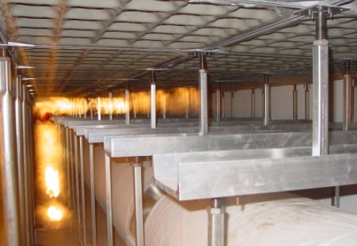
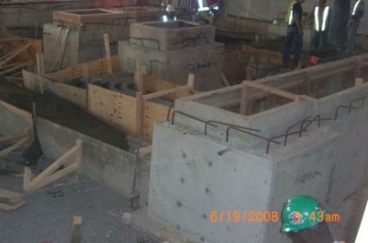
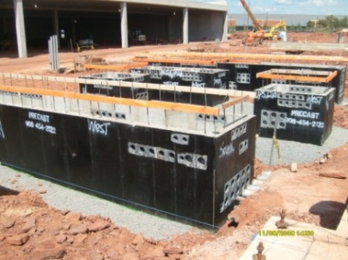
Constructability Analysis
Constructability Analysis
Project Overview
Industry & the Economy
  Existing Schedule & Cash Flow
  Project Execution Plan
  Conclusions & Recommendations
Alternative Concrete Construction Process
  Constructability Analysis
  Schedule Analysis
  Cost Analysis
  Conclusions & Recommendations
Energy Efficient Technologies
  Thin Film PV’s
  Water-side Economizers
Conclusions & Recommendations
Q & A
Underground Conduit
Access Floor
Metal channels to bridge the piping
  Less bridging required
Quicker/easier to install on a continuous surface
  Less worries about falling and maneuvering
Requirements | Trenches |  | No Trenches
Coordination | UG Electrical UG Plumbing | Storm Lines Sanitary Lines | None – SOG on top of underground systems
Excavation | Underground systems + Trench depth *Lines crossing trenches must be lower |  | Underground systems
Maximum Tile: 24”x24”
Piping Diameter: 8”-30”
(+ insulation)
Chilled Water Piping
Precast UPS Pits
No bridging required for new design
  Rest on slab mounted tube steel
Leak containment only 6” as opposed to 3’-4’ with trenches
  Require flat/level slabs to prevent ponding
Quicker & easier to install
Install Options:
  Pre-coordination – Rough-ins
  Post-coordination – Core-drill
Lindsay Hagemann | Construction Management
Mid-Atlantic Data Center 5 Ashburn, Virginia
April 13, 2009

Slide 16
Schedule Analysis
Schedule Analysis
Project Overview
Industry & the Economy
  Existing Schedule & Cash Flow
  Project Execution Plan
  Conclusions & Recommendations
Alternative Concrete Construction Process
  Constructability Analysis
  Schedule Analysis
  Cost Analysis
  Conclusions & Recommendations
Energy Efficient Technologies
  Thin Film PV’s
  Water-side Economizers
Conclusions & Recommendations
Q & A
Sequence | Original Duration | New Duration
Computer Room | 5/28/08 – 8/15/08 (50 days) | 7/2/08 – 8/6/08 (26 days)
UPS Room | 6/12/08 – 8/15/08 (47 days) | 6/23/08 – 8/1/08 (30 days)
Mechanical Room 2 | 8/1/08 – 8/22/08 (16 days) | 8/1/08 – 8/14/08 (10 days)
Admin. Office Area | 8/4/08 – 9/16/08 (32 days) | 8/13/08 – 9/19/08 (28 days)
Phase II SOG | 9/11/08 – 2/10/09 (109 days) | 9/18/08 – 12/2/08 (54 days)
Topping Slab | 6/4/08 – 10/14/08 (95 days) | 8/14/08 – 10/14/08 (44 days)
Transformer Yard | 10/17/08 – 10/28/08 (8 days) | 8/28/08 – 9/8/08 (8 days)
Alter sequences for a majority of the rooms
Precast dictates the OPS
  Original Schedule: Sporadic concrete pours
  New Schedule: Continuous concrete pours
Allow larger duration between precast erection and concrete pour sequences
  Eliminates the chance of pours catching up to precast
  Allows for smoother, continuous pour sequences
  Crews constantly working and no wasted time between pours
Delay subcontractor start date to June 18, 2008 vs. May 28, 2008
Lindsay Hagemann | Construction Management
Mid-Atlantic Data Center 5 Ashburn, Virginia
April 13, 2009

Slide 17
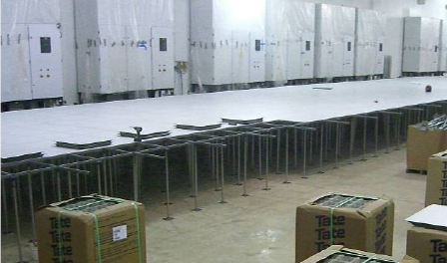
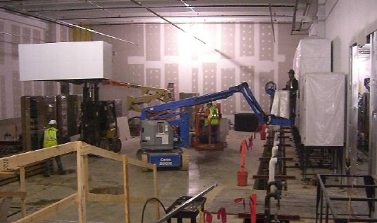
Schedule Analysis
Schedule Analysis
Project Overview
Industry & the Economy
  Existing Schedule & Cash Flow
  Project Execution Plan
  Conclusions & Recommendations
Alternative Concrete Construction Process
  Constructability Analysis
  Schedule Analysis
  Cost Analysis
  Conclusions & Recommendations
Energy Efficient Technologies
  Thin Film PV’s
  Water-side Economizers
Conclusions & Recommendations
Q & A
Other Affected Activities
Results
Sealing Concrete
  SOGs sealed earlier
Concrete Contractor Savings 65 days
OPS Savings 15 days
Discrepancy due to activates not on critical path & other trade sequences
  Precast Concrete
  Electrical Equipment
  Power
Precast and concrete dictate the ability to install the equipment
All equipment must be in place before starting commissioning
  Only go as fast as the last UPS room
Access Floor Install Time
  5 days to 4 days
CWP & Insulation Install Time
  Piping : 15 days to 10 days
  Insulation: 5 days to 3 days
Medium Voltage 1 (MV)
  MV equipment installed earlier
  Level 3 commissioning
Set CRAH Stands/Units – earlier delivery
Lindsay Hagemann | Construction Management
Mid-Atlantic Data Center 5 Ashburn, Virginia
April 13, 2009

Slide 18
Cost Analysis
Cost Analysis
Project Overview
Industry & the Economy
  Existing Schedule & Cash Flow
  Project Execution Plan
  Conclusions & Recommendations
Alternative Concrete Construction Process
  Constructability Analysis
  Schedule Analysis
  Cost Analysis
  Conclusions & Recommendations
Energy Efficient Technologies
  Thin Film PV’s
  Water-side Economizers
Conclusions & Recommendations
Q & A
Construction Cost Comparison
General Conditions Savings
 | Material | Labor | Equipment | Total
Original Process | $ 5,488,661 | $ 1,142,884 | $ 325,848 | $ 7,227,393
Alternative Process | $ 5,140,523 | $ 1,096,322 | $ 316,720 | $ 6,599,565
% Savings | 6% | 4% | 3% | 9%
Company | Total Cost | Duration (wk) | Unit Cost ($/wk) | Savings (wk) | Savings ($)
Holder Construction Construction Manager | $ 7,025,338 | 58 | $ 121,000 | 3.0 | $ 363,000
Dynalectric (Dyna) Electrical Contractor | $ 1,756,335 | 58 | $ 30,000 | 3.0 | $ 90,000
John J. Kirlin (JJK) Mechanical Contractor | $ 1,756,335 | 58 | $ 30,000 | 3.0 | $ 90,000
TOTAL |  |  |  |  | $ 543,000
HCC % Savings |  |  |  |  | 3%
Dyna % Savings |  |  |  |  | 5%
JJK % Savings |  |  |  |  | 5%
*Dyna and JJK total GC value is approximately 25% of HCC's value (per HCC estimate)
Savings = $627,828
  Precast UPS equipment
  Removing trenches
Other cost savings:
  Overhead and profit,
  Personnel
  Reduction in contractual fees.
9% Reduction
Lindsay Hagemann | Construction Management
Mid-Atlantic Data Center 5 Ashburn, Virginia
April 13, 2009

Slide 19
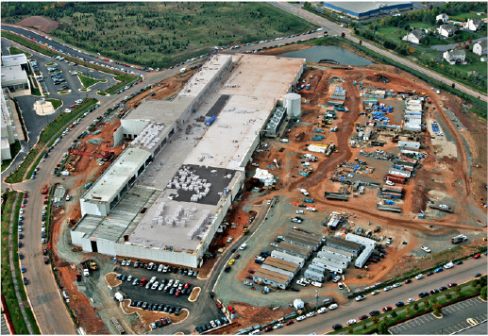
Conclusions/Recommendations
Project Overview
Industry & the Economy
  Existing Schedule & Cash Flow
  Project Execution Plan
  Conclusions & Recommendations
Alternative Concrete Construction Process
  Constructability Analysis
  Schedule Analysis
  Cost Analysis
  Conclusions & Recommendations
Energy Efficient Technologies
  Thin Film PV’s
  Water-side Economizers
Conclusions & Recommendations
Q & A
Utilize a continuous slab design in lieu of trenches.
Constructability
  Less coordination efforts due to a simpler design and less material.
  Schedule
  Concrete subcontractor onsite duration reduced 65 days
  Reduced OPS by 15 days
  Cost
  This system saves the owner $1,170,828 in construction costs.
    Concrete Contract Savings = $627,828
    Project General Conditions Savings = $543,000
Lindsay Hagemann | Construction Management
Mid-Atlantic Data Center 5 Ashburn, Virginia
April 13, 2009

Slide 20

Energy Efficient Technologies
Energy Efficient Technologies
Project Overview
Industry & the Economy
  Existing Schedule & Cash Flow
  Project Execution Plan
  Conclusions & Recommendations
Alternative Concrete Construction Process
  Constructability Analysis
  Schedule Analysis
  Cost Analysis
  Conclusions & Recommendations
Energy Efficient Technologies
  Thin Film PV’s
  Water-side Economizers
Conclusions & Recommendations
Q & A
Background
  MADC5 will be certified LEED Gold
  Data centers still consume a great deal of energy and struggle with efficiency issues.
  Escalating energy costs – harsher carbon emission policies
        Developers seeking to reduce energy costs and build “Green”
Goals
  Evaluate state-of-the-art electrical & mechanical technologies:
      Thin-Film Photovoltaic Systems for building lighting load
      Water-Side Economizers
  Implement systems that produce the following results:
      Create a more energy efficient building
      Reduce energy costs
      Relatively quick payback period (less than 10 years)
Lindsay Hagemann | Construction Management
Mid-Atlantic Data Center 5 Ashburn, Virginia
April 13, 2009

Slide 21
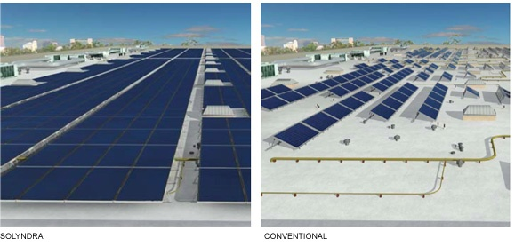
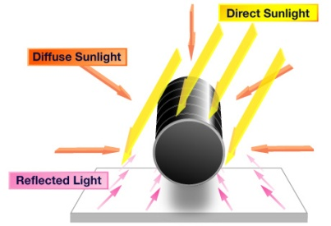
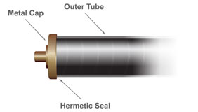
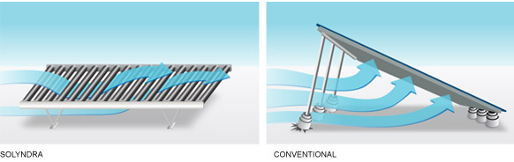
Thin-Film PV’s
Thin-Film PV’s
Project Overview
Industry & the Economy
  Existing Schedule & Cash Flow
  Project Execution Plan
  Conclusions & Recommendations
Alternative Concrete Construction Process
  Constructability Analysis
  Schedule Analysis
  Cost Analysis
  Conclusions & Recommendations
Energy Efficient Technologies
  Thin Film PV’s
  Water-side Economizers
Conclusions & Recommendations
Q & A
Research
Product Selection
CIGS (Copper-Indium-Gallium-Selenium)
  Semi-conductor light absorbing material
  Microstructure allows for cells to be a few micrometers thin
Most efficient solar technology available in the market
  19.5 % efficiency
Greater rooftop coverage
Solyndra
More electricity per rooftop
CIGS technology inside cylindrical PV panels
Panel Dimensions: 6’ x 3.5’
(40) 1-in. diameter cylinders per panel
Wind performance
  Negligible wind loads
  Sustain 130 mph
Lindsay Hagemann | Construction Management
Mid-Atlantic Data Center 5 Ashburn, Virginia
April 13, 2009

Slide 22
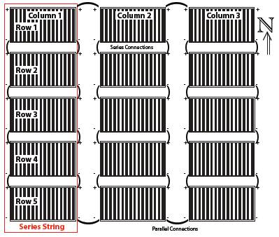
Thin-Film PV’s
Thin-Film PV’s
Project Overview
Industry & the Economy
  Existing Schedule & Cash Flow
  Project Execution Plan
  Conclusions & Recommendations
Alternative Concrete Construction Process
  Constructability Analysis
  Schedule Analysis
  Cost Analysis
  Conclusions & Recommendations
Energy Efficient Technologies
  Thin Film PV’s
  Water-side Economizers
Conclusions & Recommendations
Q & A
Design Analysis
Design Analysis
DC Wires – Combiner Boxes to Inverters
From Combiner | To Inverter | # of Arrays | Cable Size | Conduit Size
AF01 | 1 | 10 | 300 | 2"
AF02 | 1 | 10 | 4/0 | 1-1/2"
AF03 | 1 | 10 | 3/0 | 1-1/2"
AF04 | 1 | 10 | 2/0 | 1-1/4"
AF05 | 1 | 10 | 1 | 1"
AF06 | 1 | 10 | 2/0 | 1-1/4"
AF07 | 1 | 10 | 4/0 | 1-1/2"
BF01 | 2 | 10 | 300 | 2"
BF02 | 2 | 10 | 250 | 2"
BF03 | 2 | 10 | 4/0 | 1-1/2"
BF04 | 2 | 10 | 2/0 | 1-1/4"
BF05 | 2 | 10 | 1/0 | 1-1/4"
BF06 | 2 | 10 | 3/0 | 1-1/2"
BF07 | 2 | 10 | 4/0 | 1-1/2"
CF01 | 3 | 10 | 350 | 2"
CF02 | 3 | 10 | 300 | 2"
CF03 | 3 | 10 | 4/0 | 1-1/2"
CF04 | 3 | 10 | 3/0 | 1-1/2"
CF05 | 3 | 10 | 2/0 | 1-1/4"
Determine the maximum amount of panels that could fit onto the roof, which includes a main roof and a second level mezzanine roof.
  Main Roof = 236,000 SF
  Panel Size = 6 ft x 3.5 ft = 21 SF
  11,000 panels
Determine the amount of panels in each array.
  Connected in Series = 5 panels
  Connected in Parallel = 3 strings
Determine the amount of panels required to
power 508 kW building lighting load.
  Requires 19 Arrays @ 27.3 kW/array
  Array = 150 panels
  2850 Panels = 518.7 kW
Determine the amount of inverters required for the system.
  Typical:260kW inverter
  For a factor of safety: 3 inverters
Determine the wire and conduit sizes of the conductors connecting the combiner boxes to the inverters.
Lindsay Hagemann | Construction Management
Mid-Atlantic Data Center 5 Ashburn, Virginia
April 13, 2009

Slide 23
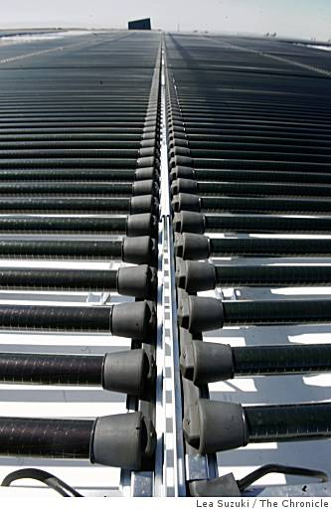
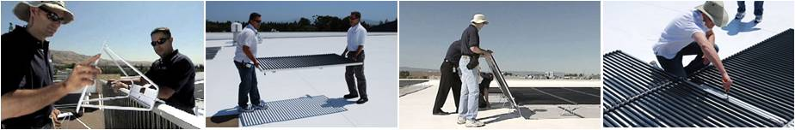
Thin-Film PV’s
Thin-Film PV’s
Project Overview
Industry & the Economy
  Existing Schedule & Cash Flow
  Project Execution Plan
  Conclusions & Recommendations
Alternative Concrete Construction Process
  Constructability Analysis
  Schedule Analysis
  Cost Analysis
  Conclusions & Recommendations
Energy Efficient Technologies
  Thin Film PV’s
  Water-side Economizers
Conclusions & Recommendations
Q & A
Constructability Analysis
Schedule Analysis
Panel Weight: 70 lbs (3.3 lbs/ ft² distributed load)
Mounting: Self-ballasted
No roof penetrations or anchoring
9” above roof membrane
Wiring: Prewired for connection to each other
#12 AWG between panels and combiner boxes
Safety: Voltage is present when sunlight is present
Labor Rate for 5-man Crew: 15 panels/hour
Number of Panels: 2,850
Installation Duration: 190 hrs = 24 Days
Affected Activities:
  Roof Completion Sept. 12, 2008
  Level 3 Commissioning start-up Dec. 1, 2008
  Available Time Period: 2.5 months
Lindsay Hagemann | Construction Management
Mid-Atlantic Data Center 5 Ashburn, Virginia
April 13, 2009

Slide 24
Thin-Film PV’s
Thin-Film PV’s
Project Overview
Industry & the Economy
  Existing Schedule & Cash Flow
  Project Execution Plan
  Conclusions & Recommendations
Alternative Concrete Construction Process
  Constructability Analysis
  Schedule Analysis
  Cost Analysis
  Conclusions & Recommendations
Energy Efficient Technologies
  Thin Film PV’s
  Water-side Economizers
Conclusions & Recommendations
Q & A
Cost Analysis
PV Avg. Power Output (kWh/yr) | Electricity Cost ($/kWh) | Total Savings | Savings (lbs of CO₂/yr)
687,796 | 0.068 | $46,770 | 962,914
Description |  | Cost
System |  | $3,316,700
 | Panels (2,850)
 | Wiring from Panels to Combiner Boxes
 | Combiner Boxes
 | Inverter
 | Labor
Monitoring System |  | $22,900
20-yr Warranty for Inverter/System |  | $62,000
Permitting |  | $5,000
Electrical Installation (Conduit & Labor for Combiner Box to Grid) |  | $320,400
TOTAL INSTALLATION COST |  | $3,727,000
Installation Cost $/W |  | $7.19
Incentives
Business Energy Investment Tax (30%) |  | $1,118,100
Local Option Property Tax Exemption for Solar |  | $0.00
Post Incentive Installation Cost |  | $2,608,900
Installation Cost $/W |  | $5.03
Funding Opportunities
Business Energy Investment Tax Credit
  30% tax credit on solar energy systems
Local Option Property Tax Exemption for Solar
  VA - solar energy equipment can be exempt from property taxes
Recommendation
Given the incentives, carbon taxes, escalated prices, and protecting the environment, it is recommended that the system is implemented.
Description | Electricity Cost ($/kWh) | Total Savings | Payback | + Carbon Tax ($0.1082) | Payback
Current Cost | 0.068 | $46,770 | 55.8 yrs. | $121,190 | 21.5 yrs.
Escalated Energy Costs
Escalation Costs | 0.10 | $68,780 | 37.9 yrs. | $143,200 | 18.2 yrs.
 | 0.20 | $137,560 | 19.0 yrs. | $211,980 | 12.3 yrs.
 | 0.30 | $206,340 | 12.6 yrs. | $280,760 | 9.3 yrs.
$2,608,900
Lindsay Hagemann | Construction Management
Mid-Atlantic Data Center 5 Ashburn, Virginia
April 13, 2009

Slide 25
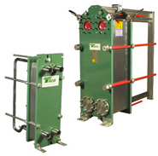
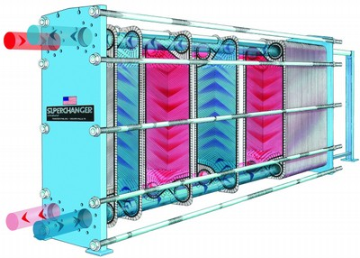
Water-Side Economizers
Water-Side Economizers
Project Overview
Industry & the Economy
  Existing Schedule & Cash Flow
  Project Execution Plan
  Conclusions & Recommendations
Alternative Concrete Construction Process
  Constructability Analysis
  Schedule Analysis
  Cost Analysis
  Conclusions & Recommendations
Energy Efficient Technologies
  Thin Film PV’s
  Water-side Economizers
Conclusions & Recommendations
Q & A
Purpose
Allows cooling towers to produce chilled water when weather conditions permit.
Bypass chillers if wet-bulb temperature is below 24°F
How
Pre-cools the chilled water prior to flowing into the evaporator
Heat transfer from the CHWR to the CW loop from the cooling tower.
Lowers the temperature of the water entering the evaporator, reducing the chiller load and energy consumption.
Ideal in temperate climates, i.e. Washington, D.C.
No schedule impact
Wet Bulb Temp. | Cooling Load (tons) | Cooling Efficiency (kWh/ton) | Electricity Cost ($/kWh) | Load Hours (h) | Savings per Chiller | Total Savings | Savings (lbs of CO₂/Plant)
24°F | 840 | 0.5 | 0.068 | 803 | $22,934 | $183,472 | 4,704
Cost = $376,000
Description | Electricity Cost ($/kWh) | Total Savings | Payback | + Carbon Tax ($0.1082) | Payback
Current Cost | 0.068 | $183,472 | 2.05 yrs. | $475,400 | 9.5 mos.
Escalated Energy Costs
Escalation Costs | 0.10 | $269,808 | 1.39 yrs. | $561,744 | 8.0 mos.
 | 0.20 | $539,616 | 8.4 mos. | $831,552 | 5.4 mos.
 | 0.30 | $809,424 | 5.6 mos. | $1,101,360 | 4.1 mos.
Recommendation
Implement (8) water-side economizers for Phase I construction.
Lindsay Hagemann | Construction Management
Mid-Atlantic Data Center 5 Ashburn, Virginia
April 13, 2009

Slide 26
Conclusions
Recommendations
Project Overview
Industry & the Economy
  Existing Schedule & Cash Flow
  Project Execution Plan
  Conclusions & Recommendations
Alternative Concrete Construction Process
  Constructability Analysis
  Schedule Analysis
  Cost Analysis
  Conclusions & Recommendations
Energy Efficient Technologies
  Thin Film PV’s
  Water-side Economizers
Conclusions & Recommendations
Q & A
Project Execution Plan
  Maintain schedule durations with less overlap = No Suspension
  Shorter construction schedule (6 months) & $ 33,251,400 additional revenue
  Future development
Analysis | Cost Savings | Schedule Savings | Additional Savings
New Execution Plan* | - | 6 mo. | $33,251,400 Additional Revenue in 6 months
Continuous Slab Design* | $1,170,828 | 0.5 mo. | 65 days for the concrete subcontractor
Thin-Film PV’s | ($2,608,900) | No effect | $183,472 in electricity cost & 962,914 lb of CO₂ saved annually
Water side Economizers* | ($376,000) | No effect | $46,770 in electricity cost & 4,704 lb of CO₂ saved annually
* Savings - 3 systems Total Savings | $794,828 (-1,814,072) | 6.5 mos. 6.5 mos.
Alternative Concrete Construction Process
  Continuous slab system
  Concrete contractor off-site 65 days earlier & accelerates OPS 15 days
  $1,170,828 Owner savings
Thin-Film Photovoltaic System
  Reduce electrical system grid dependency & energy consumption
  55.8 year payback
Water-Side Economizers
  Reduce mechanical system energy consumption
  2 year payback
Lindsay Hagemann | Construction Management
Mid-Atlantic Data Center 5 Ashburn, Virginia
April 13, 2009

Slide 27

Questions?
Acknowledgements
Project Overview
Industry & the Economy
  Existing Schedule & Cash Flow
  Project Execution Plan
  Conclusions & Recommendations
Alternative Concrete Construction Process
  Constructability Analysis
  Schedule Analysis
  Cost Analysis
  Conclusions & Recommendations
Energy Efficient Technologies
  Thin Film PV’s
  Water-side Economizers
Conclusions & Recommendations
Q & A
The Pennsylvania State University Donnally Vujcic Associates
Dr. Riley Prof. Robert Holland Hasmukh Patel
Dr. Messner Prof. Kevin Parfitt Ron Runnion
Holder Construction Company CCG Integrated Facilities, Inc.
Blake Edwards Mark Bacus John Hamburger
Paul Jorgensen Greg Smith Tommy Breard
Aaron Martens Angel Holthus Mike Mckenna
Jonathan Galvin Mark Maska
Bryan Bramlett Tyler Antil Carlisle SynTec
Josh Thompson Jason Bell Chris Cope
Jason Fleege TJ Thrasher Mike Meier
DuPont Fabros Technology The Morin Company, LLC
Scott Davis Joe Ambrogio Steve Wanishin
Faran Kaplan
Lindsay Hagemann | Construction Management
Mid-Atlantic Data Center 5 Ashburn, Virginia
April 13, 2009

